Slide 1
GPU enhanced Neuronal Networks (GeNN)
Neurotech Symposium, 08 June 2021, ONLINE
Prof Thomas Nowotny
School of Engineering and Informatics
University of Sussex
Main GeNN developers: James Turner, Esin Yavuz, Jamie Knight

Slide 2
Graphical Proceesing Units (GPUs)
GPUs are massively parallel devices that are the muscle behind recent AI developments
E.g. NVIDIA Titan RTX:
  CUDA cores: 4,608
  GPU memory: 24GB
  Memory bandwidth: Up to 672 GB/s

Slide 3
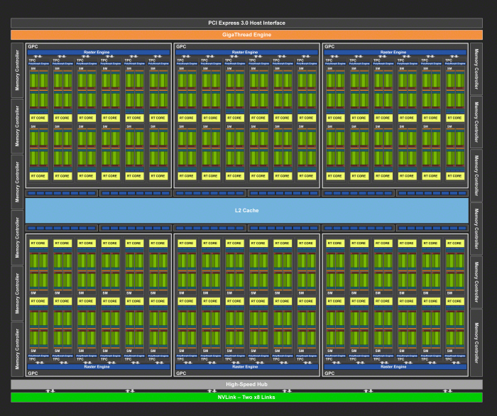
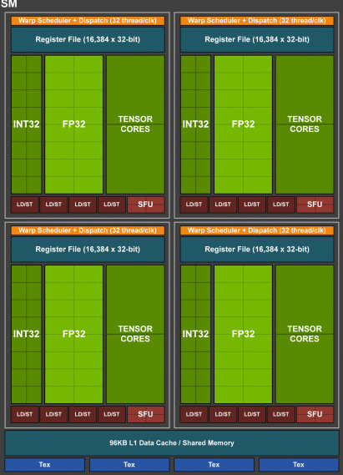
64 CUDA cores per SM

Slide 4
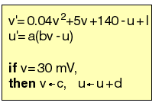
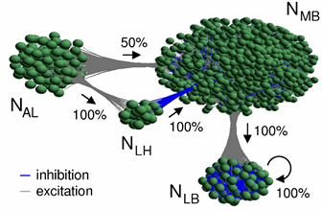
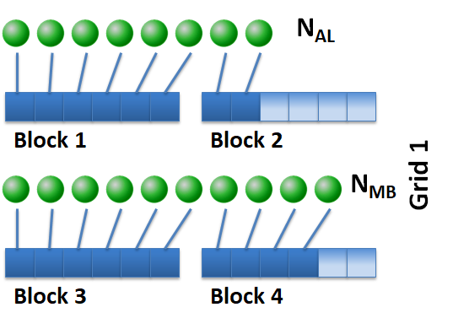
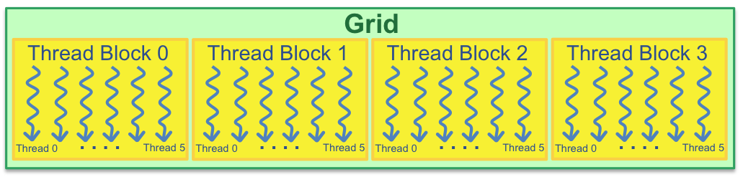
Mapping SNNs to GPU
Bean-counting!

Slide 5
GeNN (GPU enhanced Neural Networks)
GeNN generates CUDA kernels and data transfer “convenience functions” based on a model definition provided by a user.
(Meta Compiler)

Slide 6

GeNN ecosystem
Brian2
SpineCreator
PyNN
TensorFlow
PyNN GeNN
mlGeNN
Brian2GeNN
SpineML2GeNN
PyGeNN
GeNN
C++ backend
Generic SIMT backend
Python
C++
OpenCL backend
CUDA backend
CUDA/C++
OpenCL/C++
https://github.com/genn-team/genn/
Notes:
At this point I often like to show a small example how to use GeNN but I will park that for now – if anyone is interested I am happy to do this at the end.

Slide 7
How it works
Neuron populations:
Number of neurons
neurons model
Parameters
Initial values
Synapse populations:
Source neuron population
Target neuron population
Weightupdate model
Postsynaptic model
Parameters
Initial values
PyGeNN Demo

Slide 8
Brian2GeNN
from brian2 import *
import brian2genn
set_device('genn', directory='shortEx')
tau = 5*ms
eqs = '''
dV/dt = k/tau : 1
k : 1
'''
G = NeuronGroup(10, eqs, threshold='V>1', reset='V=0')
G.k = linspace(1, 5, len(G))
H = NeuronGroup(10, 'V:1')
S = Synapses(H, G, post='V_pre += 1')
S.connect(j='i')
run(101*ms)

Slide 9
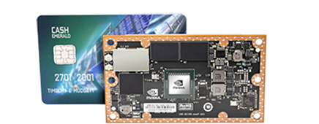

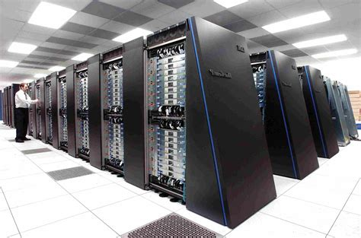
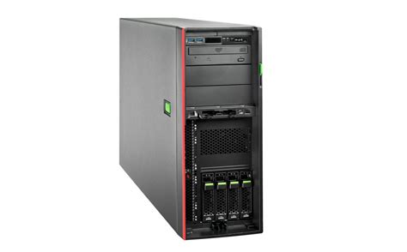
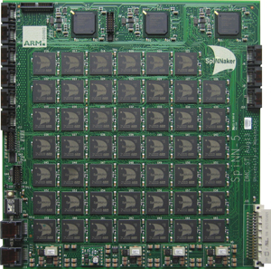

Microcircuit model: Simulation speed
SpiNNaker now runs in realtime
Titan RTX (Turing architecture) with latest GeNN is faster than realtime
Latest “HPC fastest” can now do faster than realtime
1
3
2
Rhodes O, et al. Philos Trans A Math Phys Eng Sci. (2020) 378:20190160.
Knight and Nowotny, unpublished
Markus Diesmann, personal communication, March 2021

Slide 10
Why and when GeNN?
Why:
Easy way to use GPU acceleration
Very flexible,
  allowing custom models for neurons, synapses, learning, initialization
  full control over simulation loop and I/O
  Linux/ MacOS/ Windows & including embedded systems (robotics)
When:
Large spiking models (within reason)
Long simulations with and without learning
“realtime” on robots

Slide 11
Procedural connectivity
Idea goes back to Izhikevich 2006: Instead of saving synapses, save random seeds & re-generate connectivity in parallel “on the fly”
By using counter-based random generators (Salmon, Moraes, et al. 2011), pseudo-random numbers can be generated in parallel for such algorithms with minimal memory overhead

Slide 12

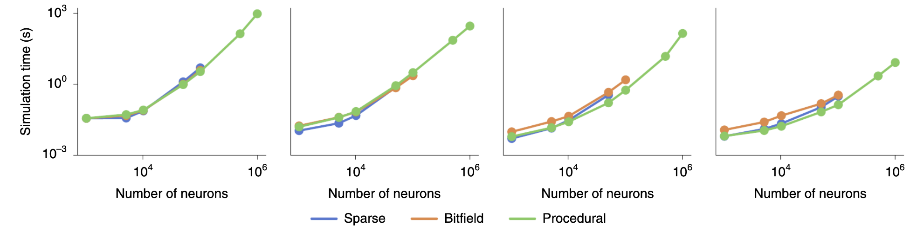
Benchmark: Balanced random network
Jetson TX2
GeForce MX130
GeForce GTX 1650
Titan RTX
Knight and Nowotny, Nature Comput Sci 1:136-142 (2021)

